Slide 1
Pokémon EDA
June 2025
EDA on Pokemon Dataset
By Team 4:
Saurav Raj Aryal
Shristhi Tamang
Manjil Shrestha

Slide 2
Data Overview:
Extensive Collection
Core Combat Stats
Elemental Types
Over 800 unique Pokémon records captured
Key attributes: HP, Attack, Defense, Speed
Primary and secondary types for each Pokémon

Slide 3
Dataset Structure: A Closer Look at the Data
Rows
800
Columns
13
Profiling Tool
ydata profiling used for initial scan
Key Findings
Identified data types and missingness

Slide 4

Data Cleaning: Preparing for Analysis
1
Type 2 Imputation
2
Duplicate Check
Missing secondary types addressed
Minor duplicate entries handled
3
Analysis Ready
Dataset now prepared for deep analysis

Slide 5
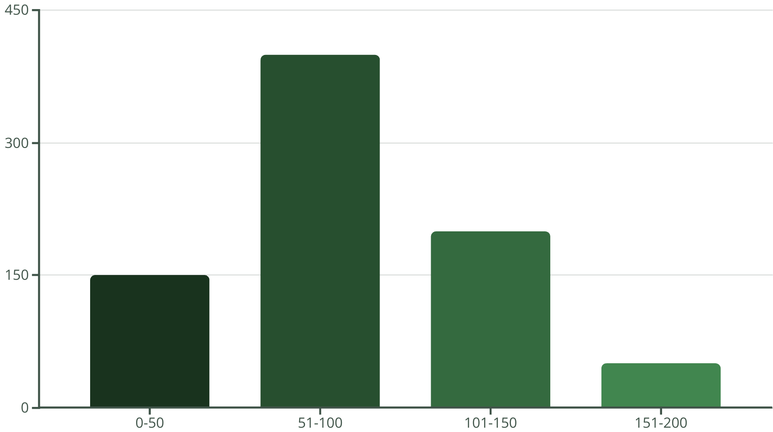
HP Distribution: Understanding Survivability
The histogram of Hit Points (HP) reveals common and rare survivability ranges among Pokémon. Most Pokémon fall within the 51-100 HP range, indicating a balanced distribution, with fewer having very high or very low HP.

Slide 6
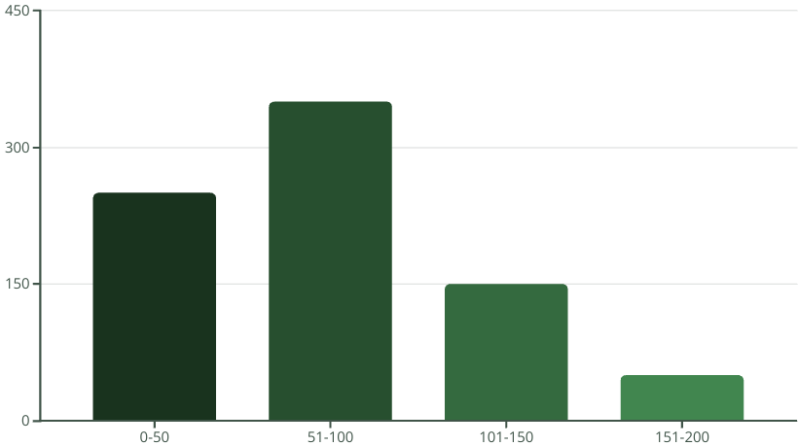
Special Attack Distribution: Unpacking Power
The distribution of Special Attack (Sp. Atk) values shows how powerful Pokémon can be in their special moves. We observe a varied range, with some Pokémon possessing exceptionally high Sp. Atk stats, indicating their potential as formidable special attackers.

Slide 7





Power Metric: Gauging Overall Strength
Speed
Attack
Defense
Power
Determines turn order
Physical damage output
Physical damage resistance
Combined strength metric

Slide 8
Key Insights: Unlocking Data's Secrets
Type Distribution
High Power Pokémon
Stat Correlations
Dominant and rare Pokémon types identified
Outliers with exceptional combined stats
Relationships between different battle stats revealed

Slide 9
Summary: From Raw Data to Actionable Intelligence
Clean Data
1
Robust and reliable dataset ready for use
Visualized Insights
2
Key patterns and trends brought to light
Actionable Metrics
3
Custom 'Power' metric provides new perspective

Slide 10



Next Steps: Expanding Our Analysis
Interactive Visuals
2
Build dynamic dashboards for deeper exploration
Predictive Modeling
1
Develop models to predict Pokémon types based on stats
Feature Engineering
Explore new features and integrate external data sources
3

